Slide 1
CPU Scheduling

Slide 2
CPU Scheduling
Basic Concepts
Scheduling Criteria
Scheduling Algorithms
Thread Scheduling
Multiple-Processor Scheduling
Real-Time CPU Scheduling
Operating Systems Examples
Algorithm Evaluation

Slide 3

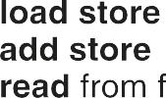
Basic Concepts
Maximum CPU utilization obtained with multiprogramming
CPU–I/O Burst Cycle – Process execution consists of a cycle of CPU execution and I/O wait
CPU burst followed by
I/O burst
CPU burst distribution is of main concern

Slide 4


CPU Scheduler
Short-term scheduler selects from among the processes in ready queue, and allocates the CPU to one of them
Queue may be ordered in various ways
CPU scheduling decisions may take place when a process:
Switches from running to waiting state
Switches from running to ready state
Switches from waiting to ready
Terminates
For situations 1 and 4, there is no choice in terms of scheduling. A new process (if one exists in the ready queue) must be selected for execution.
For situations 2 and 3, however, there is a choice.

Slide 5
Preemptive and Nonpreemptive Scheduling
When scheduling takes place only under circumstances 1 and 4, the scheduling scheme is nonpreemptive.
Otherwise, it is preemptive.
Under Nonpreemptive scheduling, once the CPU has been allocated to a process, the process keeps the CPU until it releases it either by terminating or by switching to the waiting state.
Virtually all modern operating systems including Windows, MacOS, Linux, and UNIX use preemptive scheduling algorithms.

Slide 6
Preemptive and Nonpreemptive Scheduling
Preemptive scheduling can result in race conditions when data are shared among several processes.
Consider the case of two processes that share data. While one process is updating the data, it is preempted so that the second process can run. The second process then tries to read the data, which are in an inconsistent state.
This issue will be explored in detail in Chapter 6.

Slide 7
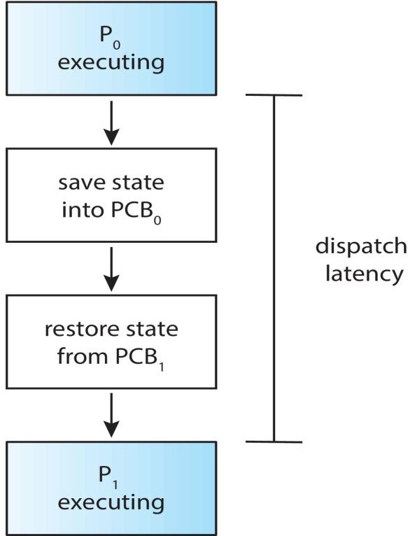
Dispatcher
Dispatcher module gives control of the CPU to the process selected by the CPU scheduler; this involves:
Switching context
Switching to user mode
Jumping to the proper location in the user program to restart that program
Dispatch latency – time it takes for the dispatcher to stop one process and start another running

Slide 8
Scheduling Criteria
CPU utilization – keep the CPU as busy as possible
Throughput – number of processes that complete their execution per time unit
Turnaround time – amount of time to execute a particular process
Waiting time – amount of time a process has been waiting in the ready queue
Response time – amount of time it takes from when a request was submitted until the first response is produced, not output (for time- sharing environment)

Slide 9
Scheduling Algorithm Optimization Criteria
Max CPU utilization
Max throughput
Min turnaround time
Min waiting time
Min response time

Slide 10
First- Come, First-Served (FCFS) Scheduling
Process Burst Time
P₁ 24
P₂ 3
3
P₃
Suppose that the processes arrive in the order: P₁ ,
P₂ , P₃
The Gantt Chart for the schedule is:
P₁ | P₂ | P₃
0 24
Waiting time for P₁ = 0; P₂ = 24; P₃ = 27
27
30
Average waiting time: (0 + 24 + 27)/3 = 17

Slide 11
FCFS Scheduling
Suppose that the processes arrive in the order:
P₂ , P₃ , P₁
The Gantt chart for the schedule is:
P₂ | P₃ | P₁
0
3
6
30
Waiting time for P₁ = ?; P₂ = ?; P₃ = ?
Average waiting time: ???
Much better than previous case ?
Convoy effect - short process behind long process
– Consider one CPU-bound and many I/O-bound processes
12

Slide 12
Shortest-Job-First (SJF) Scheduling
Associate with each process the length of its next CPU burst
Use these lengths to schedule the process with
the shortest time
SJF is optimal – gives minimum average waiting time for a given set of processes
The difficulty is knowing the length of the next
CPU request
Could ask the user

Slide 13
Example of SJF
Process | Burst Time
P₁ | 6
P₂ | 8
P₃ | 7
P₄ | 3
SJF scheduling chart
P₄ | P₁ | P₃ | P₂
0
3
9
16
24
Average waiting time = ??? For FCFS = ???

Slide 14
Example of Shortest-remaining- time-first
Now we add the concepts of varying arrival times and preemption to the analysis
Process | Arrival Time | Burst Time
P₁ | 0 | 8
P₂ | 1 | 4
P₃ | 2 | 9
P₄ | 3 | 5
Preemptive SJF Gantt Chart
P₁ | P₂ | P₄ | P₁ | P₃
0 1 5 10 17 26
Average waiting time = [(10-1)+(1-1)+(17-2)+5- 3)]/4 = 26/4 = 6.5 msec

Slide 15
Round Robin (RR)
Each process gets a small unit of CPU time (time quantum q), usually 10-100 milliseconds. After this time has elapsed, the process is preempted and added to the end of the ready queue.
If there are n processes in the ready queue and the time quantum is q, then each process gets 1/n of the CPU time in chunks of at most q time units at once. No process waits more than (n-1)q time units.
Timer interrupts every quantum to schedule next process
Performance
q large ⇒ FIFO
q small ⇒ q must be large with respect to context
switch, otherwise overhead is too high

Slide 16
Example of RR with Time Quantum = 4
Process | Burst Time
P₁ | 24
P₂ | 3
P₃ | 3
The Gantt chart is:
P₁ | P₂ | P₃ | P₁ | P₁ | P₁ | P₁ | P₁
0
4
7
10
14
18
22
26
30
Typically, higher average turnaround than SJF, but better response
q should be large compared to context switch time
q usually 10ms to 100ms, context switch < 10 usec

Slide 17
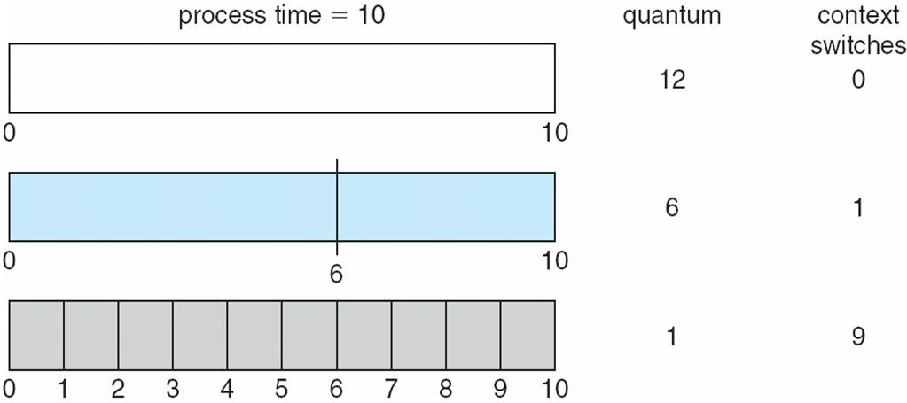
Time Quantum and Context Switch Time

Slide 18
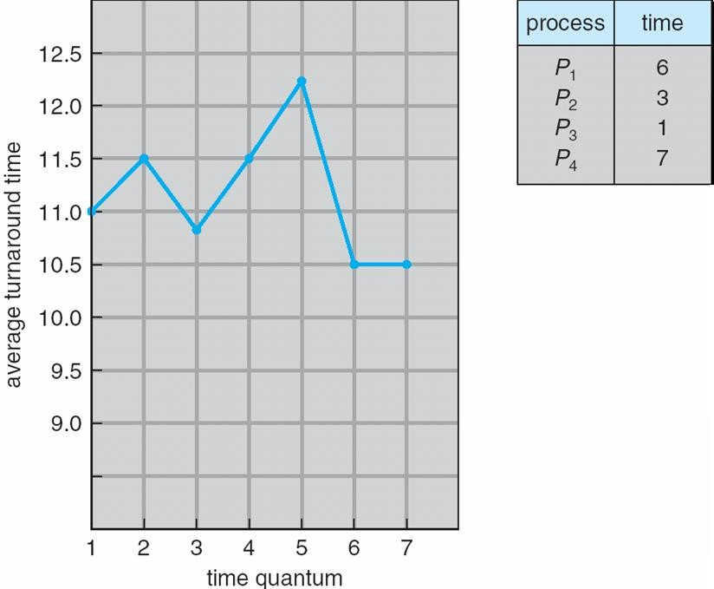
Turnaround Time Varies With The Time Quantum
80% of CPU bursts should be shorter than q

Slide 19
Priority Scheduling
A priority number (integer) is associated with each process
The CPU is allocated to the process with the highest priority (smallest integer ≡ highest priority)
Preemptive
Nonpreemptive
SJF is priority scheduling where priority is the inverse of predicted next CPU burst time
Problem ≡ Starvation – low priority processes may never execute
Solution ≡ Aging – as time progresses increase the priority of the process

Slide 20
Example of Priority Scheduling
Process | Burst Time | Priority
P₁ | 10 | 3
P₂ | 1 | 1
P₃ | 2 | 4
P₄ | 1 | 5
P₅ | 5 | 2
Priority scheduling Gantt Chart : ???
Average waiting time = 8.2 msec

Slide 21
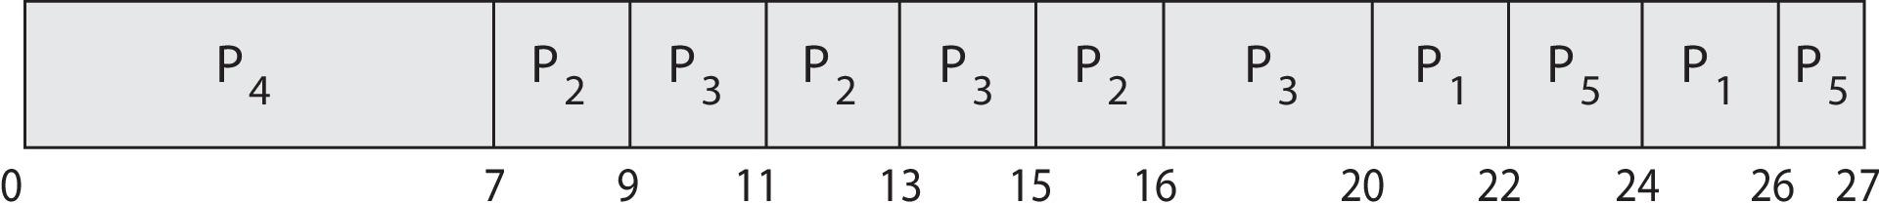
Priority Scheduling w/ Round-Robin
Process | Burst Time | Priority
P₁ | 4 | 3
P₂ | 5 | 2
P₃ | 8 | 2
P₄ | 7 | 1
P₅ | 3 | 3
Run the process with the highest priority. Processes with the same priority run round-robin
Gantt Chart with time quantum = 2

Slide 22
Example 1
Consider the following set of processes, with the length of the CPU burst
time given in milliseconds:
Process Burst Time Priority
P1 2 2
P2 1 1
P3 8 4
P4 4 2
P5 5 3
The processes are assumed to have arrived in the order P1, P2, P3, P4, P5,
all at time 0.
a. Draw four Gantt charts that illustrate the execution of these processes
using the following scheduling algorithms: FCFS, SJF, non preemptive
priority (a larger priority number implies a higher
priority), and RR (quantum = 2).
b. What is the turnaround time of each process for each of the
scheduling algorithms in part a?
c. What is the waiting time of each process for each of these scheduling
algorithms?
d. Which of the algorithms results in the minimum average waiting
time (over all processes)?

Slide 23
Example 2
The following processes are being scheduled using a preemptive, roundrobin
scheduling algorithm.
Process Priority Burst Arrival
P1 40 20 0
P2 30 25 25
P3 30 25 30
P4 35 15 60
P5 5 10 100
P6 10 10 105
Each process is assigned a numerical priority, with a higher number indicating
a higher relative priority. In addition to the processes listed below, the system also has an idle task (which consumes no CPU resources and is identified as Pidle). This task has priority 0 and is scheduled when is identified as Pidle). This task has priority 0 and is scheduled whenever the system has no other available processes to run. The length of a time quantum is 10 units. If a process is pre-empted by a higher-priority process, the pre-empted process is placed at the end of the queue.
a. Show the scheduling order of the processes using a Gantt chart.
b. What is the turnaround time for each process?
c. What is the waiting time for each process?
d. What is the CPU utilization rate?

Slide 24
Good luck for mid
Thank You

